Slide 1
Play2 + Spring + Hibernate + PostgreSQL Project hosted in Heroku Cloud
Grupo ASV

Slide 2
Index
Prerequisites
Register an Heroku Account
Uploading the Project
Accesing Cloud PostgreSQL DB
Herokurize a Play2 Project

Slide 3
Prerequisites
Play2 + Spring + Hibernate + PostgreSQL
Project hosted in Heroku Cloud

Slide 4
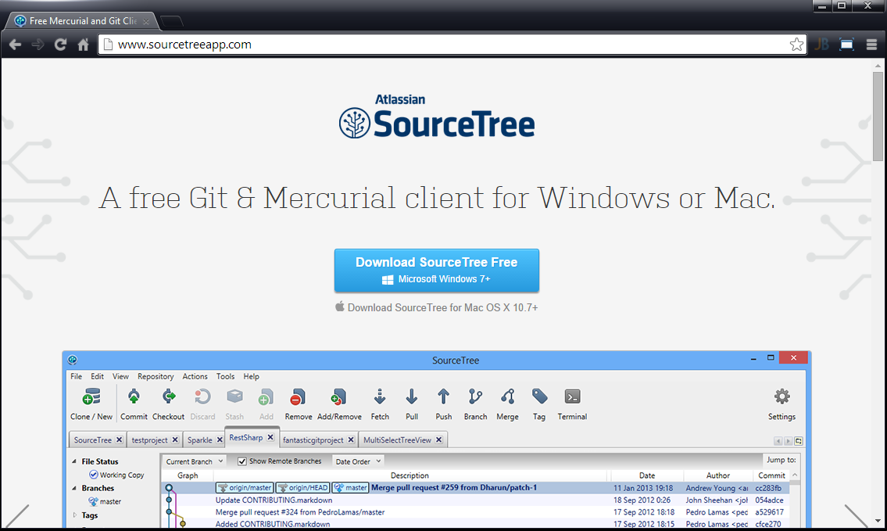
Prerequisites (Git Client)
Download and Install SourceTree
http://www.sourcetreeapp.com
Alternative and Additional:
Heroku Toolbelt
https://toolbelt.heroku.com
Git for Windows
http://msysgit.github.io

Slide 5
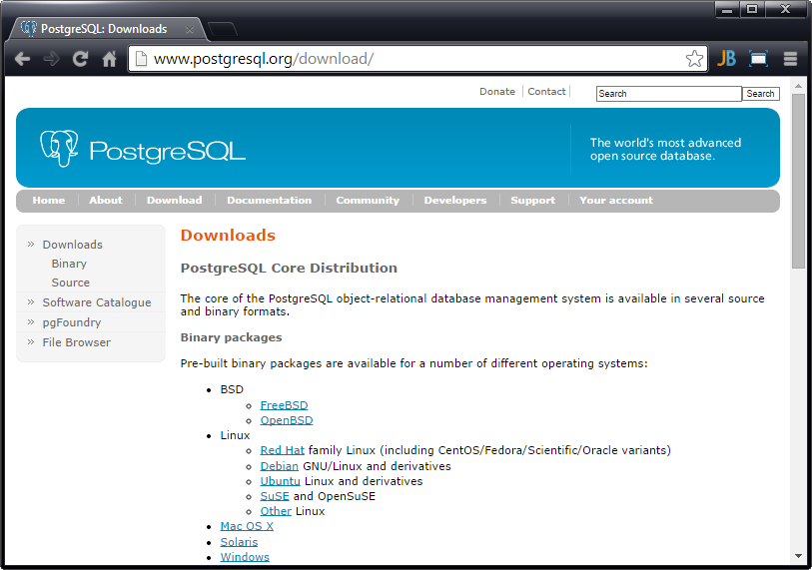
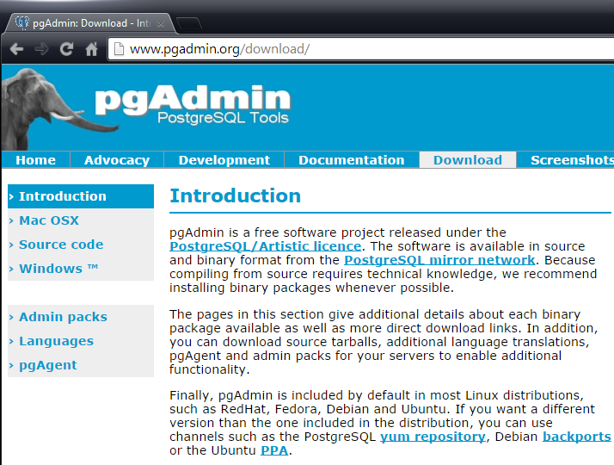
Prerequisites (PostgreSQL)
Full DB with pgAdmin:
http://www.postgresql.org/download
only pgAdmin:
http://www.pgadmin.org/download

Slide 6
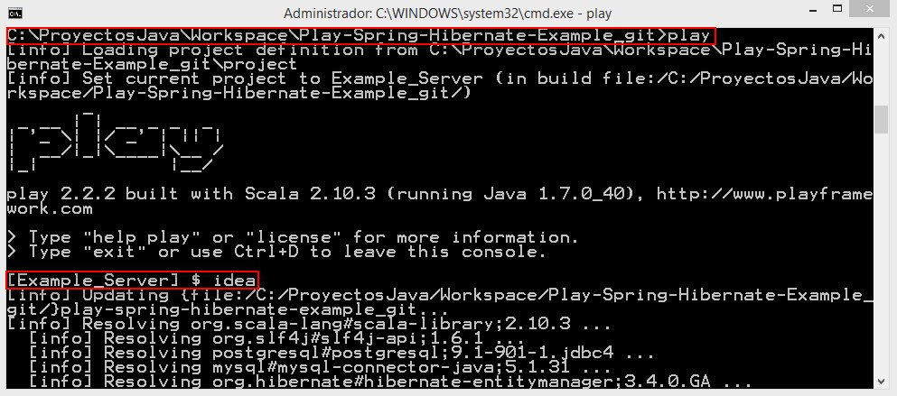
Prerequisites (Example)
Fork Example Project
from Git Hub:
https://github.com/JavierFuentes/Play2-Spring-Hibernate-PostgreSQL-Heroku-Template.git
Edit and Test first in localhost
Note.- You may need to execute PLAY IDEA from console to update dependencies out of IntelliJ.

Slide 7
Register an Heroku Account
Play2 + Spring + Hibernate + PostgreSQL
Project hosted in Heroku Cloud

Slide 8
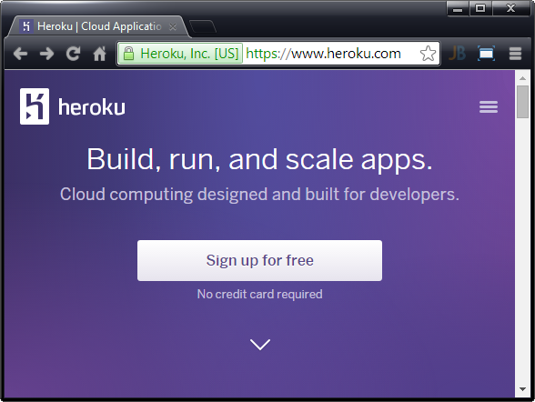
Register an Heroku Account
Go to
https://www.heroku.com
and Sign Up or Log In

Slide 9
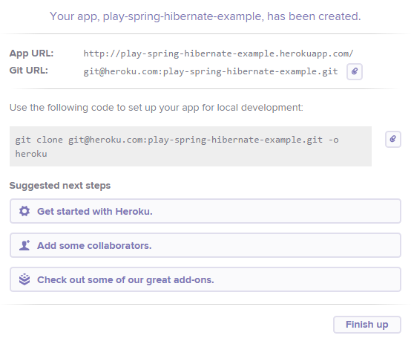
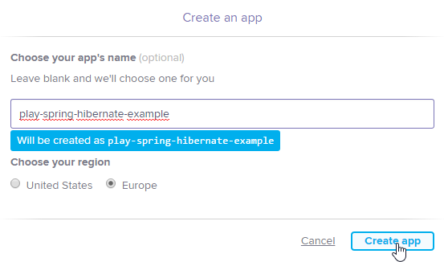
Create an App in European Region
Create a new App from Heroku Dashboard

Slide 10
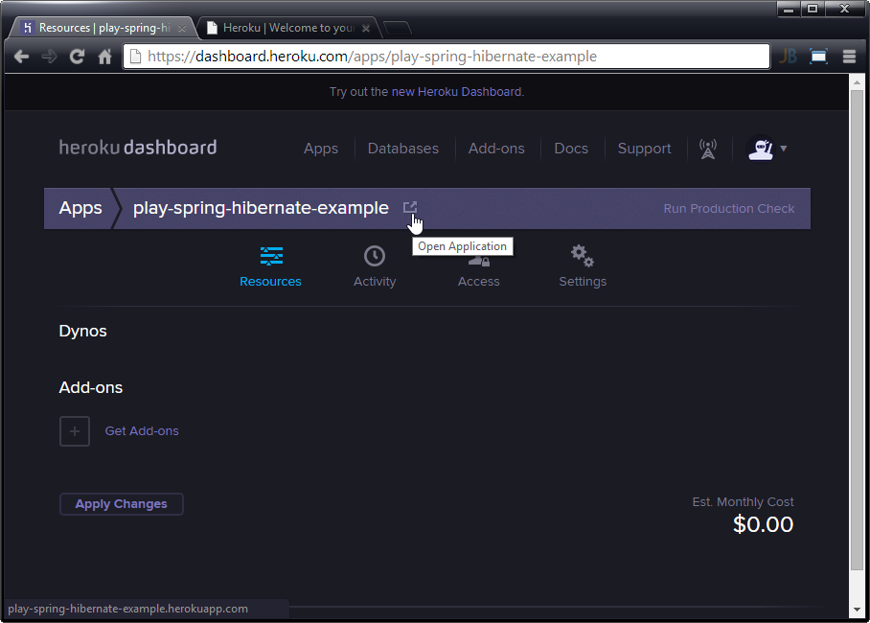
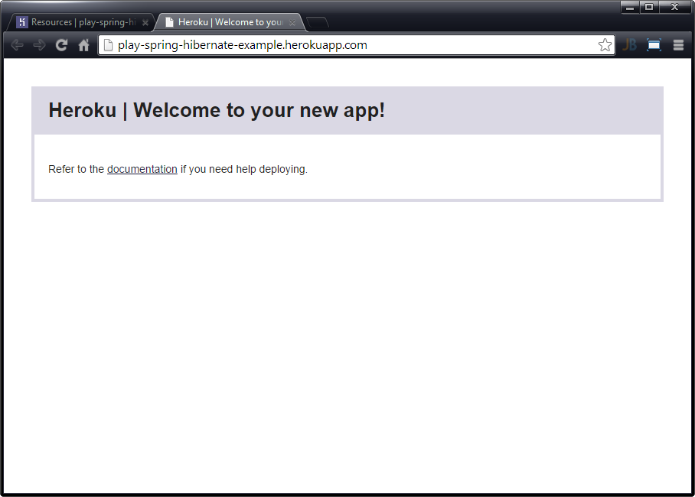
Test your App
Test your new App is running

Slide 11
Uploading the Project
Play2 + Spring + Hibernate + PostgreSQL
Project hosted in Heroku Cloud

Slide 12
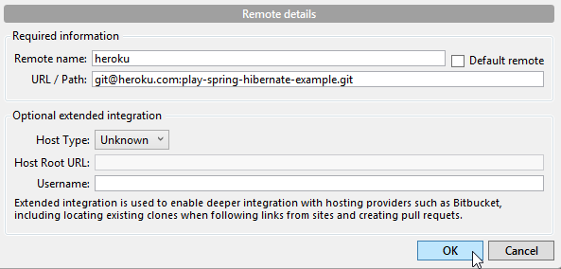
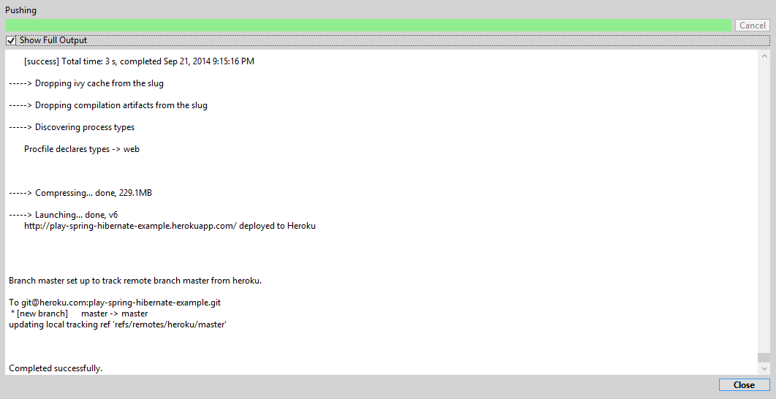
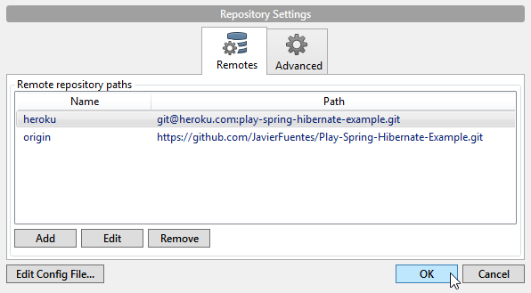
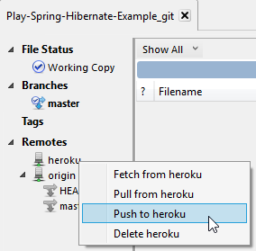
Add Aditional Remote Repository
With Source Tree its very easy.
PUSH to new Remote

Slide 13
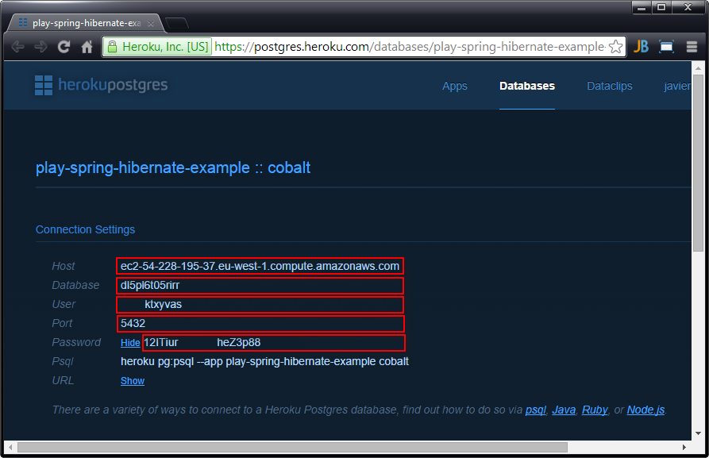
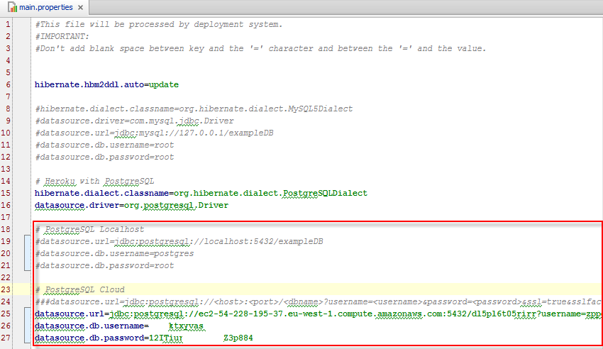
Postgres Database Settings
Push creates a new DB in Amazon and Adds-on to your App
Take settings to redirect your Project to Amazon Cloud DB editing main.properties file

Slide 14
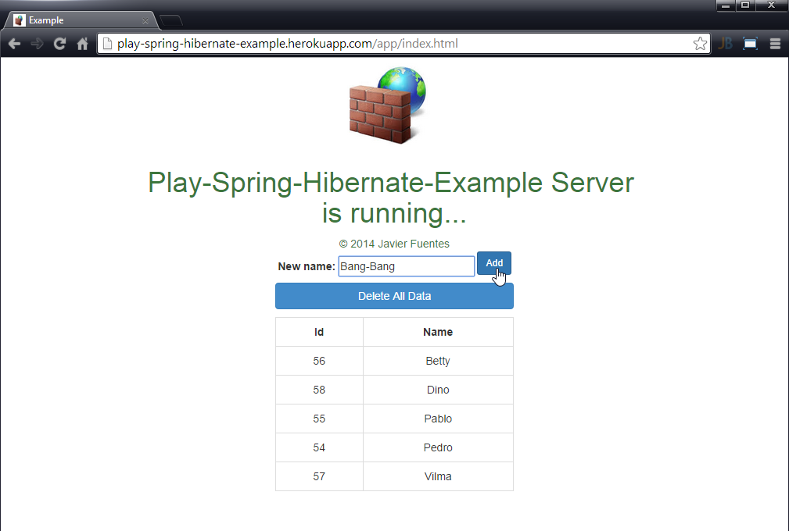
Test the App in Cloud
Commit and Push changes to Remote Heroku.
Test the App Writing and Reading data from Postgres Cloud DB.
Example: http://play-spring-hibernate-example.herokuapp.com

Slide 15
Accesing Cloud Postgres DB
Play2 + Spring + Hibernate + PostgreSQL
Project hosted in Heroku Cloud

Slide 16
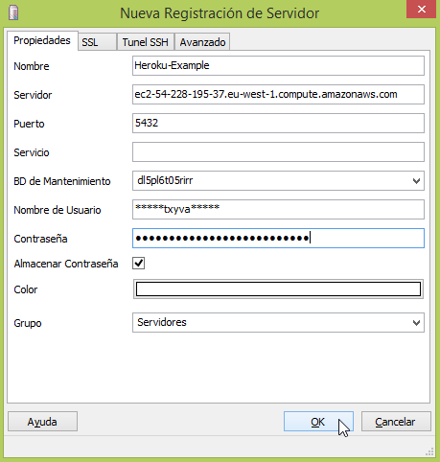
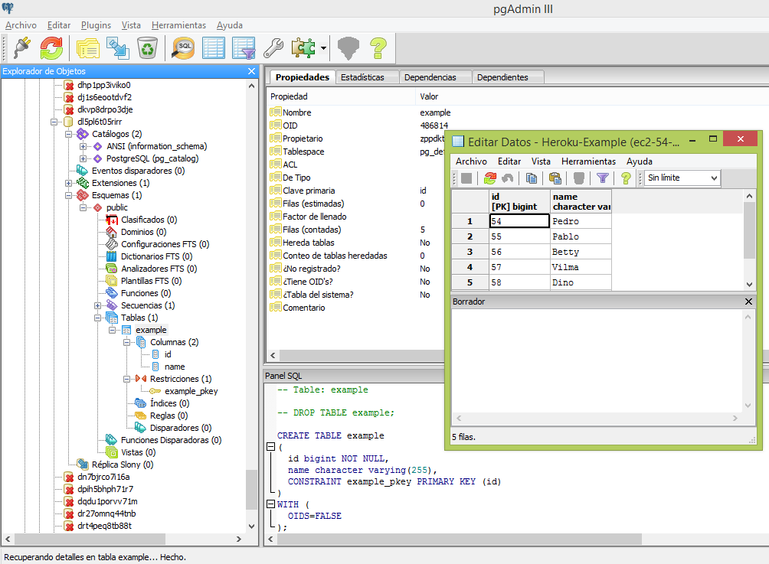
Accesing with pgAdmin
Register Server in pgAdmin
Navigate to Tables

Slide 17
Herokurize a Play2 Project
Play2 + Spring + Hibernate + PostgreSQL
Project hosted in Heroku Cloud

Slide 18

Where are the Secrets
Add Postgres dependency in build.sbt
Configure Datasource in main.properties with host, database, user & password provided by Heroku
Create and configure Procfile in root Project depending on Play version
More info in https://www.playframework.com/documentation/2.2.x/ProductionHeroku

